Slide 1
Introduction to group projects
Bio311
03/21/2017

Slide 2
Yeast as model system
Well-studied, single cell eukaryote
Important to humans (beer and wine, bread, bioprocessing, disease)
Small genome, tractable molecular genetics
Lots and lots of data available
e.g. See NIH Gene Expression Omnibus (GEO)
We will use yeast data for group projects

Slide 3
THINK / PAIR / SHARE
“Anything found to be true of E. coli must be true of elephants.”–Jacques Monod
THINK/PAIR/SHARE: What does Monod mean by this?
Model systems provide a simpler, more tractable tool to discover general principles of biology

Slide 4
Projects: biological questions
What are the molecular functions of TFs in yeast?
What are the functions of genes the TF binds?
What genes are co-expressed with the TF?
What genes are most affected by a TF knockout?
How do networks function dynamically to enable physiological and metabolic adjustment in response to environmental cues (stress, nutrients)?
What other TFs also bind the genes controlled by my TF?
How do genes controlled by the network respond to other stresses?
Notes:
Implicit in this question: how do GRN dynamics differ in extremophiles vs mesophiles? Structure? Function?

Slide 5
Example from the literature
How will we apply what we learned so far to answer the biological questions?
How will I use the literature to help answer the questions?
How do I find out what the dataset means and how the data were collected?

Slide 6
Example data, exercise 1: Understanding the biological question
Open the Baker et al. 2013 paper
Read the abstract and introduction
Skim the result and look at the figures
Answer these questions
What was the purpose of the study?
What were the main conclusions?
What evidence supports these conclusions?

Slide 7
Example data: ChIP-seq
Baker et al. 2013, Mol Cell Bio, 33:

Slide 8
Example data: Gene expression
Baker et al. 2013, Mol Cell Bio, 33:

Slide 9
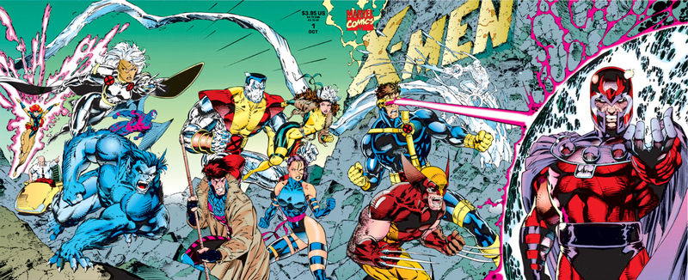
Interlude: What is a mutant?
THINK / PAIR / SHARE: Come up with two definitions of “mutant”
General or colloquial (i.e. how your grandmother may define it)
Specific to our projects – Why are they useful?

Slide 10
What is a mutant?
Genome coordinate (Mbp)
“WILD TYPE”
“TF MUTANT”
GENOTYPE --→ PHENOTYPE
Notes:
More info on this in Keely’s lecture later in the semester when we go over mutational analysis of genomics data in greater depth.

Slide 11
What is a mutant?
An individual that is genetically different from “wild-type” background (the majority of individuals of that organism in its natural environment or a commonly accepted reference )
Changes in DNA sequence (heritable)
Integral to the process of evolution and the study of genetics

Slide 12
Types of Mutations
Point mutations (single nucleotide)
Nonsense
Nucleotide change → stop codon
Missense
1 nucleotide → 1 a.a. change
Silent mutation
Same a.a. coded by mutated DNA (i.e. CGG and CGC)
Mutation affects non-coding DNA (introns, intergenic regions)
Insertions
frameshifts
Deletions
Whole gene= knock-out (or KO)
Notes:
Point of this slide, is that mutations don’t always affect a gene, and small mutations can have serious consequences

Slide 13
Think/pair/share Why make a mutant?
Study the function of a gene and its product
Efficient detection of the expression of a gene or a protein (“knock-in” reporter gene)
Bioengineering and synthetic circuits
Notes:
Function- break or change normal function of protein, look at how phenotypes and cellular interactions change
Detection-tags
Engineering- want your microbe to produce insulin, or extra antibiotics

Slide 14
Example data: Gene Ontology
Baker et al. 2013, Mol Cell Bio, 33:

Slide 15
Example data: exercise 3
Take a few minutes and write a list of data analysis methods you would use to answer these questions:
What sets of genes change expression in response to the environmental perturbation?
What patterns of expression do you observe for these genes?
What genes change in the TF knockout relative to the wild type?
What genes are directly regulated by the TF?

Slide 16
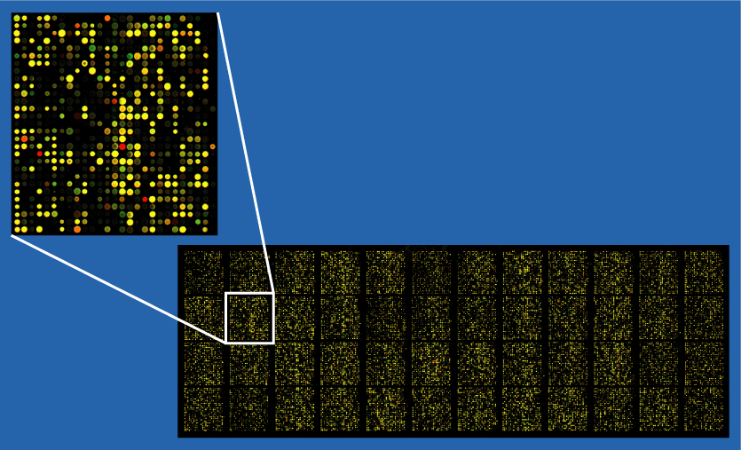
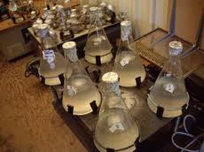
PROJECT EXPERIMENTS AND DATA
TF knockout
time or condition
RNA
ChIP-chip

Slide 17
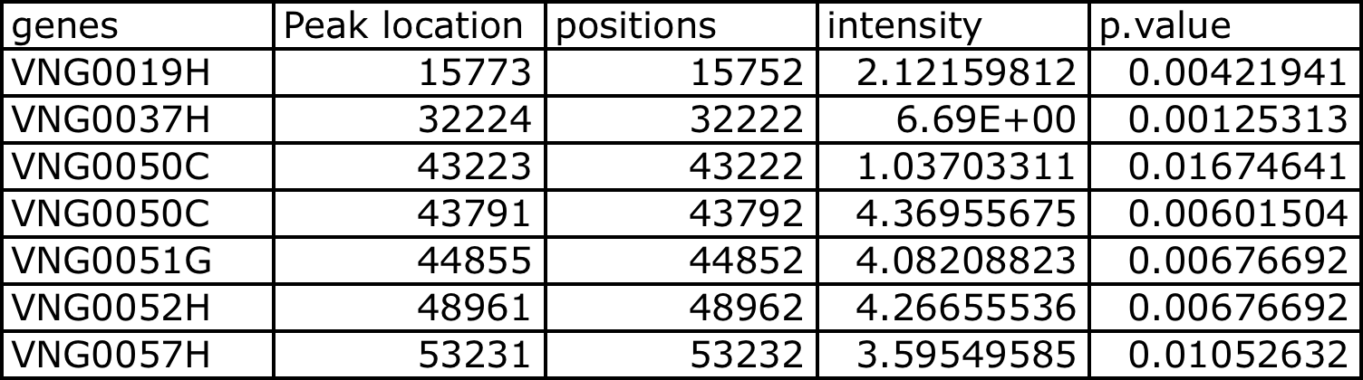
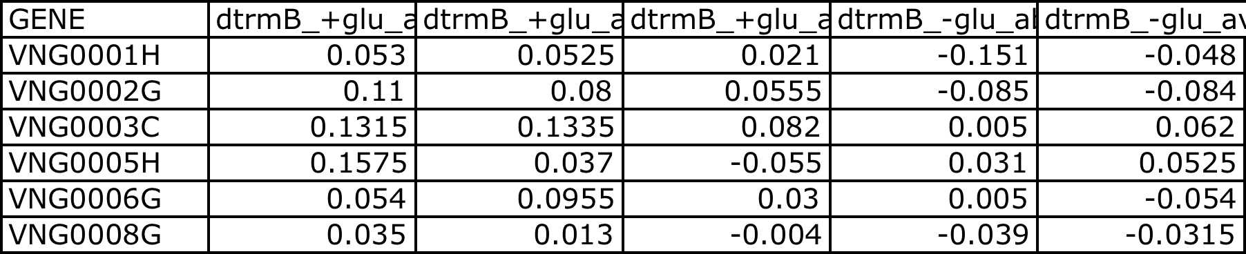
Project data: Each group will be assigned a ChIP and a gene expression dataset
ChIP-chip or -seq: binding data for 1 TF across genome
Where does the TF bind?
Gene expression: Wild type vs mutant of same TF
OR Wild type over time in response to a stress
How are genes differentially expressed in
TF knockout vs wild type?
What genes are co-expressed with the TF over time?

Slide 18
Project data: each group also has access to ChIP-chip data for all TFs
What other TFs control the genes that are controlled by my TF of interest? (What is the network controlling the stress response of interest)?
How does the expression of genes controlled by this network change over time or in response to a TF knockout?

Slide 19
EXAMPLE PROJECT WORKFLOW
Wild type data over time during stress.
Cluster genes according to common patterns
Functions of genes in each cluster
Which of these clusters contain TFs of interest?
Given correlations between TF of interest and genes in that cluster, formulate hypothesis for which genes are regulated by the TF.
Use ChIP-chip data to test the hypothesis
Make gene regulatory network for your TF
Ask which other TFs (from the larger ChIP dataset) regulate genes in your network.
Compare what you got with the findings of the paper(s) that first reported the dataset you are working with

Slide 20
THERE ARE MANY “RIGHT” ANSWERS
There are p-values, ratios, statistical confidence levels.
In scientific research, you make decisions and conclusions based on whether you are convinced by the evidence, then argue your points to the community
There are, however, “WRONG” answers
Conclusions that do not logically fit the data
Conclusions that violate known facts

Slide 21
Group membership
Choose your own group with the following stipulations:
Each group must contain 3-4 people, 10 groups total
Each group must contain at least 2 people who did not know each other outside of this class
The instructors reserve the right to rearrange some groups for balance of expertise and numbers

Slide 22
Group datasets
By Thurs. 3/23 at noon, email your choices for group membership to all three instructors.
On Thursday, work with your group to read the paper associated with your data & familiarize yourselves with data / experiment and come up with a plan.
By the end of class Thursday, hand in a bullet-point list of your group’s plan and/or preliminary figure for credit/no credit participation points.

Slide 23
PROJECT EXPECTATIONS
Be rigorous, methodical, skeptical.
Read the literature – find papers in addition to the one assigned on the topic of your project
Explore – click on things in databases for more information.
Meet with your group at least 2 hrs/week outside of class
ASK!!!! It’s ok not to know something.

Slide 24
PROJECT EXPECTATIONS
SAVE YOUR WORK (figures, notes, ideas, etc). Using Markdown will assist you!
Homework: Progress reports due periodically. The due dates, homework format, and conceptual overview will be posted on GitHub.
Present your results in a poster at end of semester.
Everyone in the group MUST PARTICIPATE. Don’t let your team down.

Slide 25
QUESTIONS?

